Slide 1
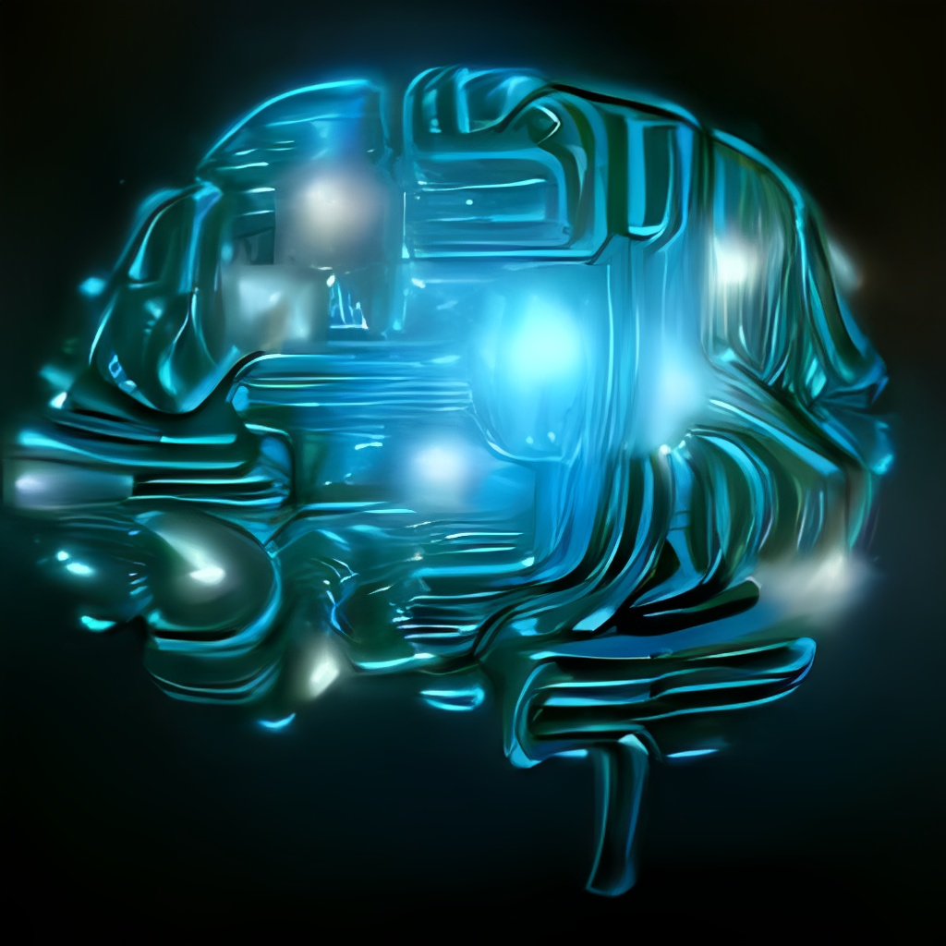

NLP and Its Applications
This presentation explores the fundamentals of Natural Language Processing (NLP) and delves into its diverse applications in AI.
Leader : Leen Naseem 202121499
Member 1 : Fatima Raed 202112013
Member 2 : Aya Khaled 202112339
Professor : Anas Al-Rabdi
This Photo by Unknown Author is licensed under CC BY-SA
Notes:
<number>

Slide 2
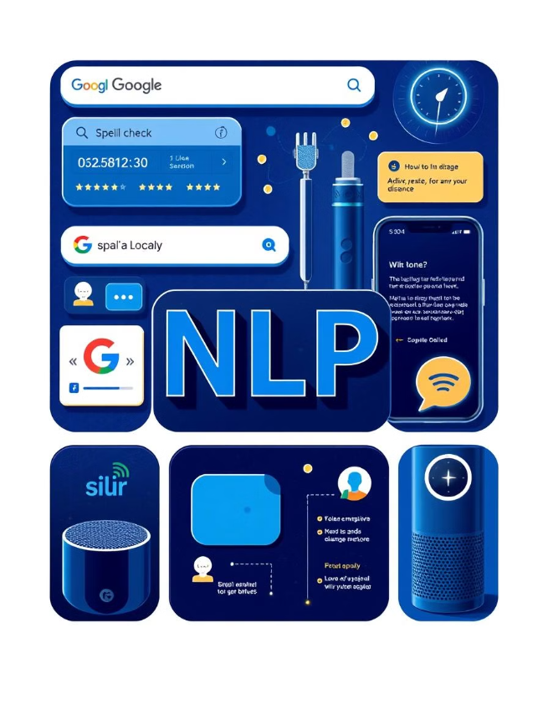
Agenda
What is NLP?
NLP Components?
Why is NLP hard?
Why is NLP important?
What are the techniques used in NLP?
How does NLP work?
Example of NLP in real life.
Applications in NLP.
Challenges in NLP.
Notes:
<number>

Slide 3

9. Libraries and tools.
10. Linguistic analysis and pre-processing steps of nlp.
11. NLP life cycle.
12. NLP vectorization.
13. Model selection building.
14. Threat detection (Final Project)
Notes:
<number>

Slide 4

What is NLP?
NLP is a branch of artificial intelligence (AI) that focuses on helping computers understand, interpret, and respond to human language in a way that's meaningful.
It's about teaching computers to "read," "listen," "write," or even "talk" like humans.
Notes:
<number>

Slide 5
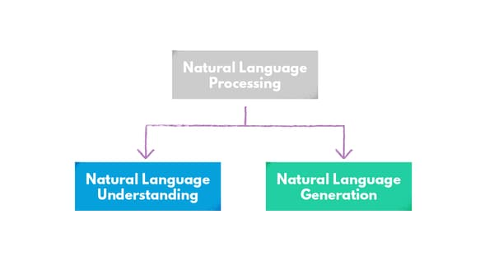
NLP Components:
The term NLP can be divided into two major components:
Natural language understanding (NLU)
Natural language generation (NLG)
NLP consist of :
Turning text into data, Then Turning data int

Slide 6
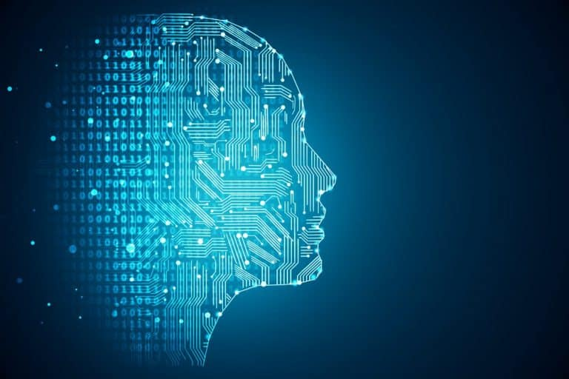
Why Is NLP Hard?
Words can mean different things (ambiguous).
Context is important, and machines struggle to understand it.
Real-world text is messy (slang, errors).
Language rules are complex.
Different languages need different models.
NLP models need a lot of computer power.
Bias in data can make models unfair.

Slide 7

Why is NLP Important?
Language is how humans express thoughts and communicate with one another, empowers computers to assist us with various tasks, including:
Translation
Question Answering
Sorting emails
Languages like Google Translate.
Like Siri or Alexa.
(e.g., marking spam).
Detect
Summarizing long texts.
Detecting the sentiment in text (e.g., happy or sad).
Notes:
<number>

Slide 8
What are the techniques used in NLP?
Tokenization: Breaking text into smaller units (words or sentences).
For example, splitting "I love ice cream" into ["I", "love", "ice", "cream"].
Part-of-Speech (POS) Tagging: Identifying the grammatical role of each word in a sentence, like whether it’s a noun, verb, adjective, etc.
Named Entity Recognition (NER): Detecting names of people, places, dates, etc., in text.
For example, in "Barack Obama was born in Hawaii," NER identifies "Barack Obama" as a person and "Hawaii" as a place.
Stemming and Lemmatization: Reducing words to their base form.
For example, "running" becomes "run" (stemming) or "better" becomes "good" (lemmatization).
Parsing: Analyzing the grammatical structure of a sentence. It helps in understanding the relationships between words.

Slide 9
What are the techniques used in NLP?
Sentiment Analysis: Determining the sentiment or emotion behind a text, like whether a review is positive or negative.
Word Embeddings: Representing words as vectors (numbers) to capture their meanings and relationships. Popular methods include Word2Vec and GloVe.
Machine Translation: Automatically translating text from one language to another (e.g., Google Translate).
Text Classification: Categorizing text into predefined labels or classes, like spam detection or topic categorization.
Sequence-to-Sequence Models: Used for tasks like translation or summarization, where the model generates a sequence of words as output based on an input sequence.
Transformers: A powerful architecture for NLP tasks (like GPT and BERT) that uses attention mechanisms to process text more efficiently.

Slide 10

How Does NLP Work?
NLP breaks down language into smaller parts, like words or sentences.
For example, the sentence " I love Pizza “
gets broken into " I ", " love ", " Pizza ".
Computers learn patterns and relationships in words, understanding meaning and performing tasks.
Notes:
<number>

Slide 11


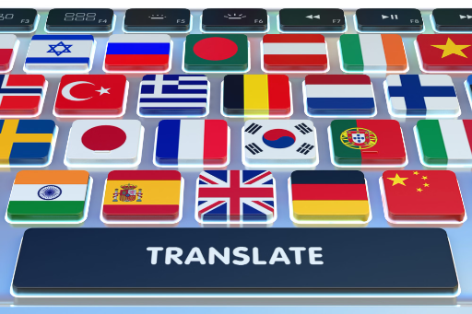
Computers learn patterns and relationships in words. For instance:
"Happy" is often the opposite of "Sad."
"Pizza" is food.
Translate "Hello" into "Hola."
Notes:
<number>

Slide 12
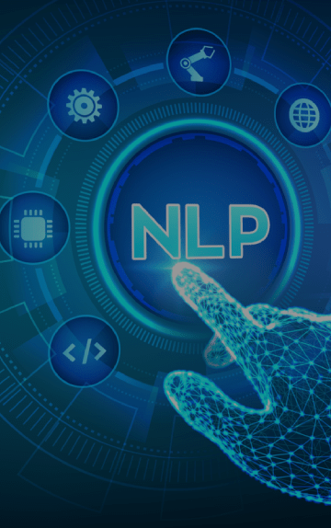
Simple Explanation of NLP Tasks
Translation: Converting "Good morning" into "Bonjour."
Chatbots: Responding to "What are your hours?" with "We are open from 9 AM to 5 PM."
Chatbots: Responding to "What are your hours?" with "We are open from 9 AM to 5 PM."
Sentiment Analysis: Understanding if a review is positive ("I loved it!") or negative ("It was terrible!").
Summarization: Turning a long article into a short summary.

Slide 13
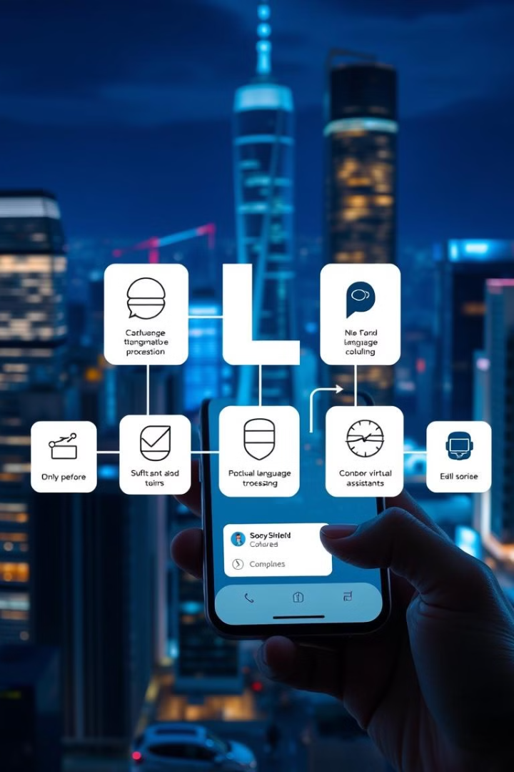
Real-Life NLP Examples
NLP is used in various everyday applications, including:
Google Search
Spell Check
Understanding your queries and showing relevant results.
Tools like Grammarly correct writing mistakes.
Voice Assistants
Alexa and Siri respond to spoken commands.
Notes:
<number>

Slide 14
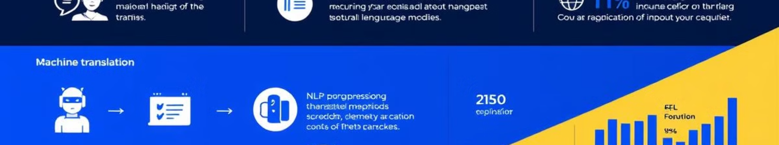



Key Applications of NLP
NLP has a wide range of applications, including:
Machine Translation
Sentiment Analysis
Named Entity Recognition (NER)
Automating language translations.
Analyzing text for emotions.
Identifying and classifying entities like names, dates, and locations in text.
Notes:
<number>

Slide 15
Key Applications of NLP
NLP has a wide range of applications, including:
Chatbots and virtual assistant
Speech recognition
Text generation
Enabling machines to engage in conversations & assist users (Siri, Alexa).
converting spoken language into written text (Google speech-text).
Automatically generating human-like text based on input (GPT-3 for content creation).
Notes:
<number>

Slide 16

Challenges in NLP Summarization
Ambiguity
Relevance
Understanding the context and meaning of sentences.
Choosing what’s important to include in the summary.
Fluency
Ensuring the summary reads naturally and grammatically.
Notes:
<number>

Slide 17

Libraries and tools:
NLTK :
Small but useful datasets with markup
Preprocessing tools: tokenization, normalization …
Pre-trained models for POS-tagging, parsing…
Stanford parser spaCy:
python and cython library for NLP
Genism:
python library for text analysis, e.g. for word
embeddings and topic modeling
MALLET:
Java-based library, e.g. for classification, sequence tagging, and topic mod

Slide 18
Tokenization:
Word Tokenizer: Splits text into individual words.
Sentence Tokenizer: Splits text into sentences.
Part-of-Speech Tagging (POS):
Identifies the grammatical role (noun, verb, adjective, etc.) of each word in a sentence.
Named Entity Recognition (NER):
Detects named entities like people, places, dates, and organizations in text.
Stemming:
Reduces words to their base or root form (e.g., "running" → "run").
Libraries and tools-NLTK

Slide 19
Frequency Distribution:
Analyzes the frequency of words or tokens in a given text.
Text Classification:
Categorizes text into predefined categories (e.g., spam detection, sentiment analysis).
Chunking:
Groups words into meaningful chunks (e.g., noun phrases, verb phrases).
Collocations:
Finds common word pairs or phrases that appear together often.
Corpus:
NLTK provides access to several pre-built corpora (large text datasets) for tasks like training models or analyzing language.
Libraries and tools-NLTK

Slide 20

In the context of Natural Language Processing (NLP), "digital algorithms" refers
to computational methods and techniques designed to process and analyze digital text or speech data.
These algorithms play a crucial role in various NLP tasks like translation, sentiment analysis, text summarization, and more.
Below are specific digital algorithms and techniques used in NLP:

Slide 21
1.Preprocessing Algorithms
2. Feature Extraction Algorithms
3. Statistical and Linguistic Algorithms
4. Sequence Labeling and Prediction
5. Machine Learning Algorithms
6. Deep Learning Algorithms
7. Sentiment Analysis Algorithms
8. Specialized Algorithms

Slide 22
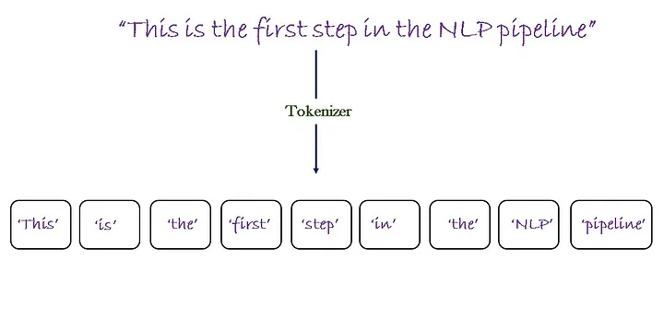
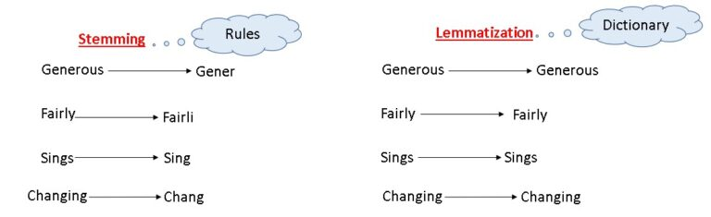
1. Preprocessing Algorithms
Tokenization: Breaking text into smaller units like words or sentences.
B. Stemming: Porter Stemmer, Snowball Stemmer.
C. Lemmatization :WordNet Lemmatizer.

Slide 23
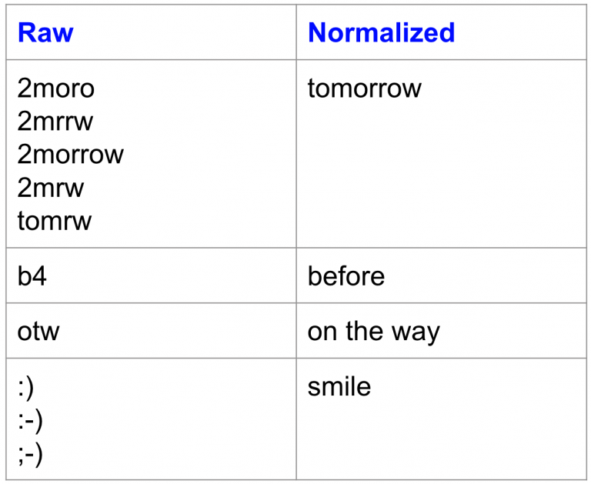
1. Preprocessing Algorithms
D. Text Normalization: Lowercasing, removing stopwords, and punctuation stripping.

Slide 24
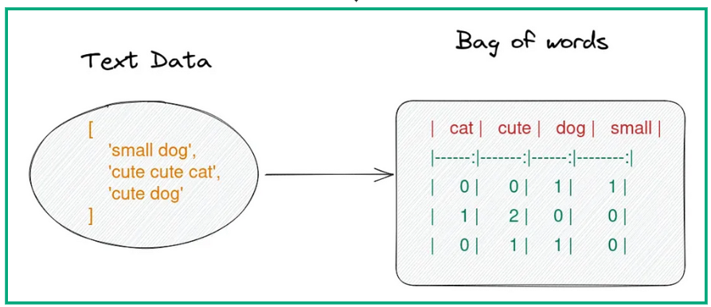
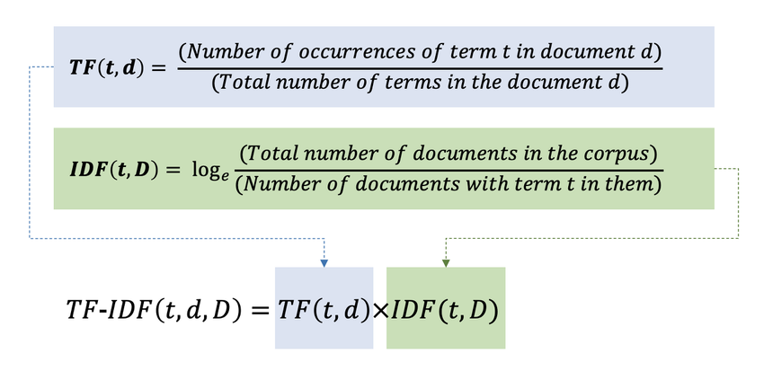
2. Feature Extraction Algorithms
Bag of Words (BoW): Represents text as a collection of word frequencies.
B. Term Frequency-Inverse Document Frequency (TF-IDF): Highlights important terms in a document relative to a corpus.

Slide 25
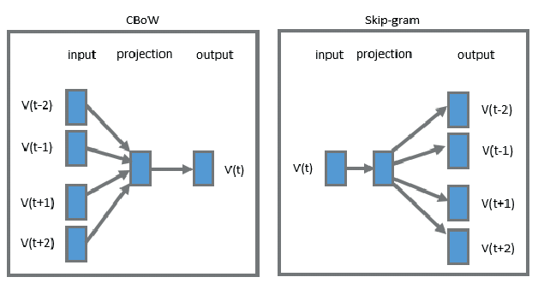
2. Feature Extraction Algorithms
C. Word Embedding Models:
Word2Vec: Skip-gram and CBOW algorithms.

Slide 26
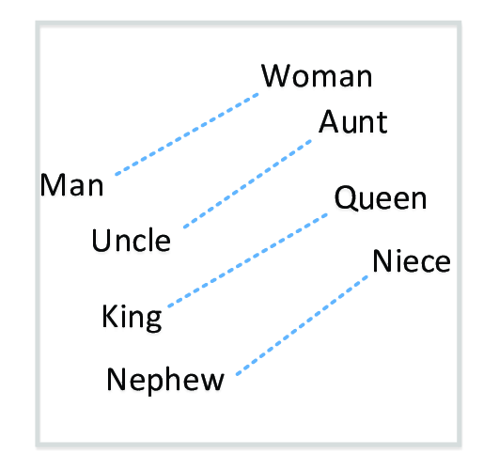
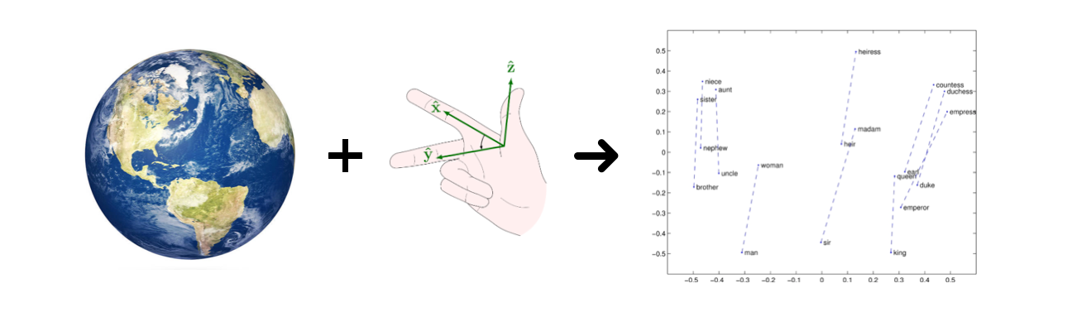
2. Feature Extraction Algorithms
C. Word Embedding Models:
2. GloVe: Global vector embeddings for word representation.

Slide 27
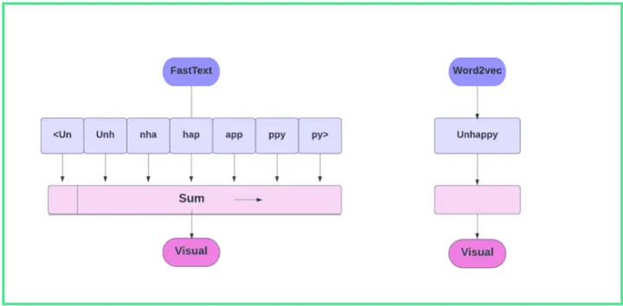
2. Feature Extraction Algorithms
C. Word Embedding Models:
3. FastText: Includes subword information for better handling of rare words.

Slide 28
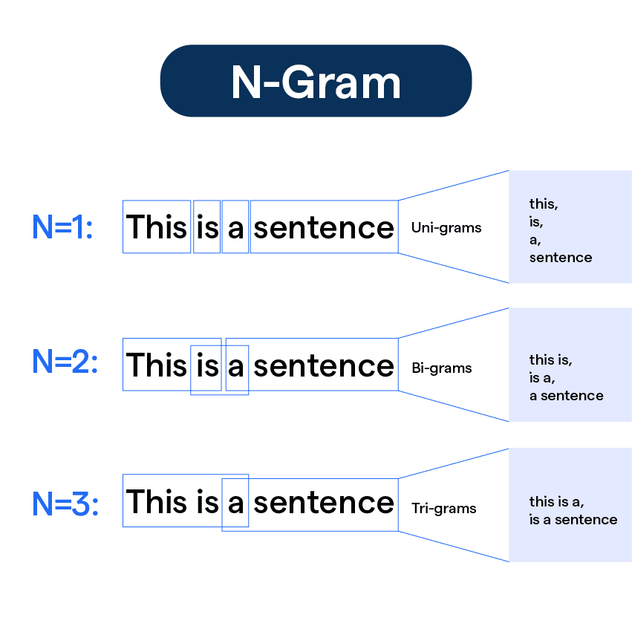
Statistical and Linguistic Algorithms
n-grams: Used for modeling word sequences and predicting the next word in text.

Slide 29
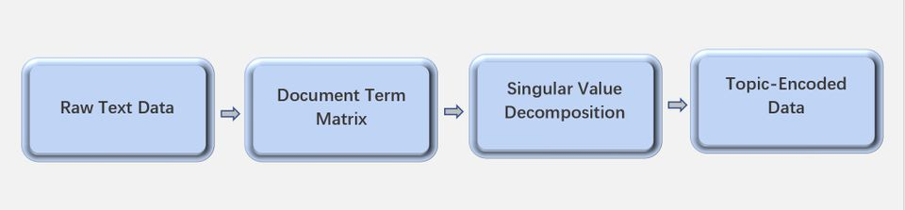
Statistical and Linguistic Algorithms
B. Latent Semantic Analysis (LSA): Captures relationships between terms in a document.

Slide 30
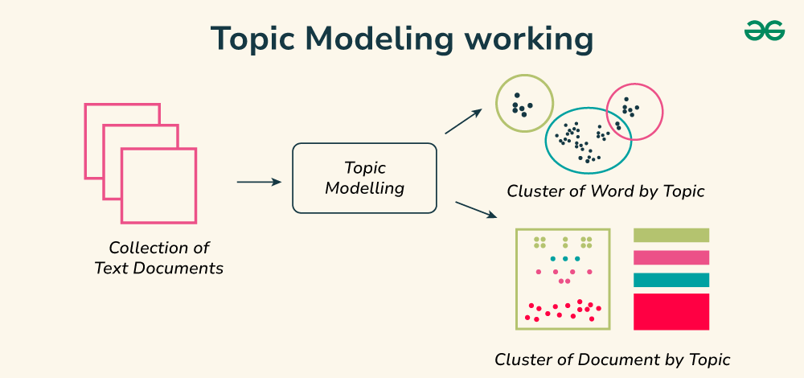
Statistical and Linguistic Algorithms
C. Latent Dirichlet Allocation (LDA): A probabilistic model for topic modeling.

Slide 31
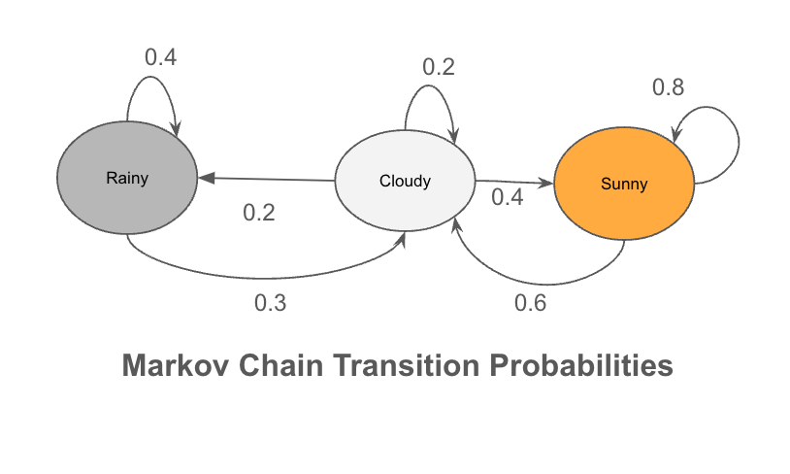
Statistical and Linguistic Algorithms
D. Markov Chains: For text generation and sequence modeling.

Slide 32
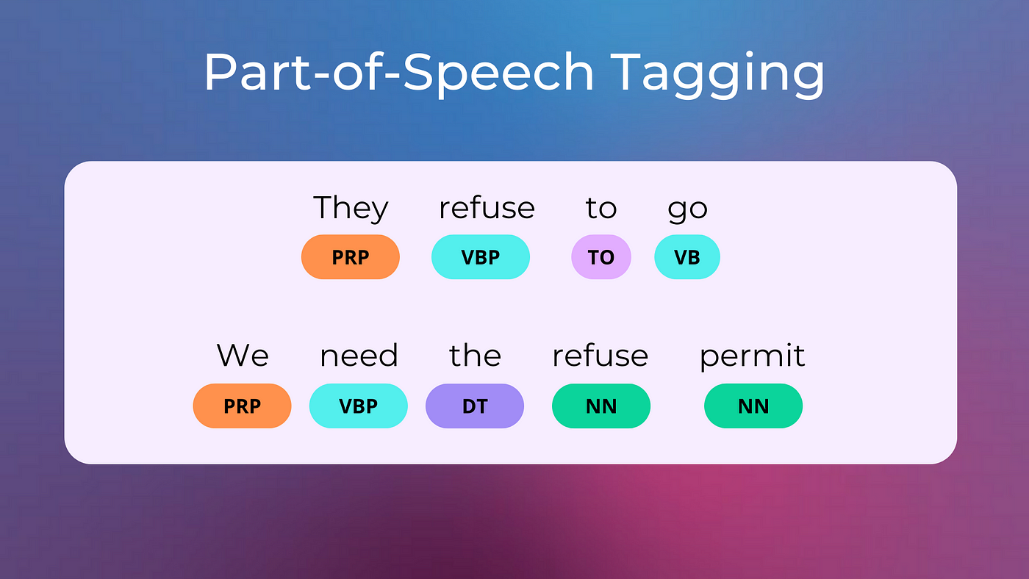
4. Sequence Labeling and Prediction
Hidden Markov Models (HMMs): For tasks like Part-of-Speech (POS) tagging.

Slide 33
4. Sequence Labeling and Prediction
Hidden Markov Models (HMMs): For tasks like Part-of-Speech (POS) tagging.

Slide 34
5. Machine Learning Algorithms
A. Classification Algorithms: Logistic Regression, SVM, and k-Nearest Neighbors (k-NN) for tasks like sentiment analysis.
Logistic Regression
SVM
k-Nearest Neighbors (k-NN)

Slide 35
5. Machine Learning Algorithms
Clustering Algorithms: k-Means for topic modeling or document clustering.
k-Means
C. Decision Trees and Random Forests: For tasks involving text classification.
Decision Trees
Random Forests

Slide 36
6. Deep Learning Algorithms
Recurrent Neural Networks (RNNs): LSTMs and GRUs for sequence-based tasks like text generation and translation.
Convolutional Neural Networks (CNNs): Used in text classification and sentence pair modeling.
Transformers: BERT, GPT, RoBERTa, T5, and XLNet for contextual embeddings and transfer learning.
Attention Mechanisms: Self-attention and multi-head attention for capturing long-range dependencies.

Slide 37
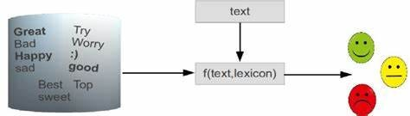
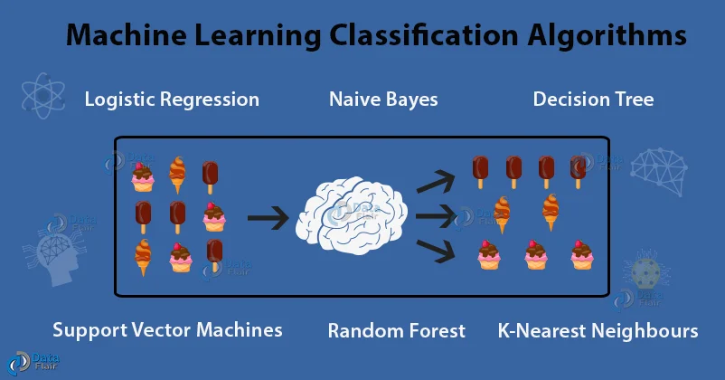
7. Sentiment Analysis Algorithms:
Lexicon-based Methods: Sentiment lexicons like SentiWordNet.
B. Machine Learning Models: SVM, Naïve Bayes, or ensemble methods.

Slide 38
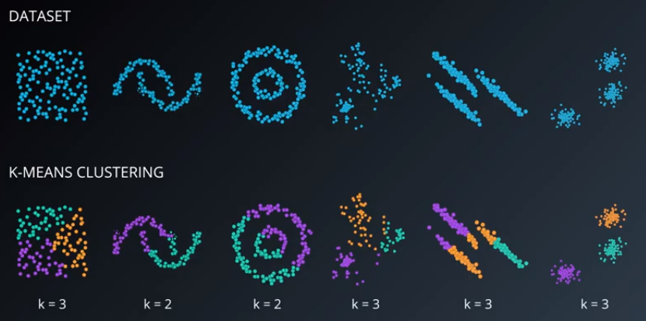
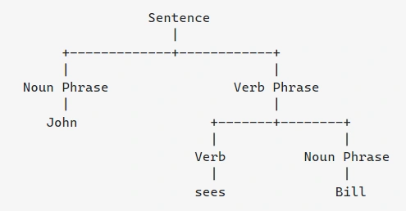
8. Specialized Algorithms
A. Text Clustering: Hierarchical clustering, DBSCAN for unsupervised tasks.
Named Entity Recognition (NER):CRFs, BiLSTM-CRF, or transformer-based models.
Dependency Parsing: Algorithms like Eisner’s algorithm for parsing sentence structures.

Slide 39
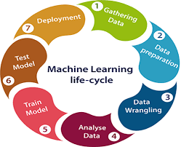
NLP life cycle.

Slide 40

Summarization in NLP
Summarization in NLP is the process of condensing large amounts of text into shorter versions while preserving key ideas and main points. It helps people save time by extracting the most important information from long documents, articles, or conversations.
Notes:
<number>

Slide 41
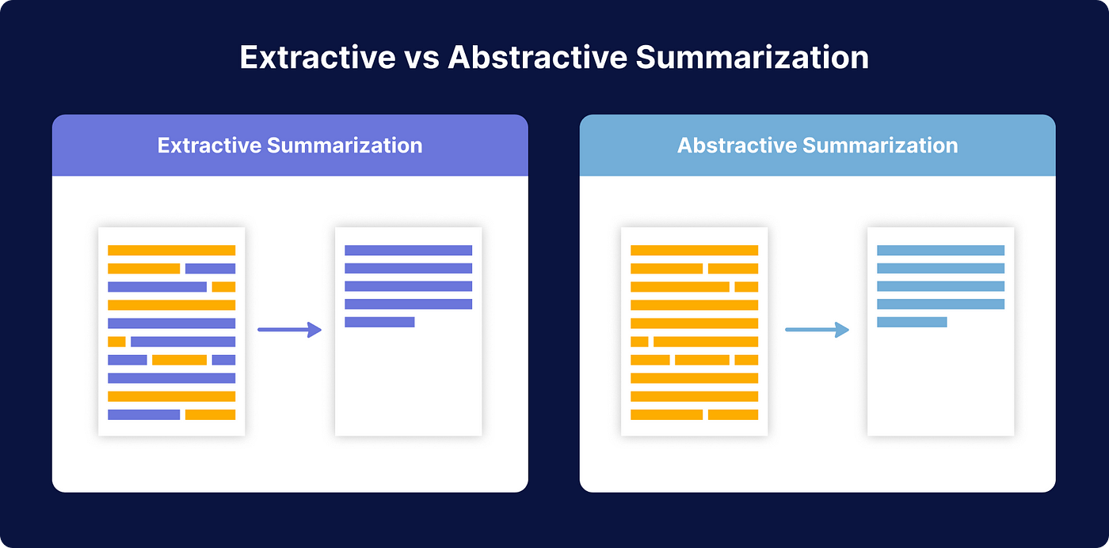
Types of Summarization
Extractive Summarization
Abstractive Summarization
The system selects the most important sentences or phrases from the text and combines them into a summary.
The system generates a summary using its understanding of the content, often paraphrasing or rewriting the text.
Notes:
<number>

Slide 42

Extractive Summarization:
Example:
Input: "The quick brown fox jumps over the lazy dog. The dog was sleeping under the tree.”
Output: "The quick brown fox jumps over the lazy dog.“
Tools: Algorithms like TextRank and LexRank.
Notes:
<number>

Slide 43
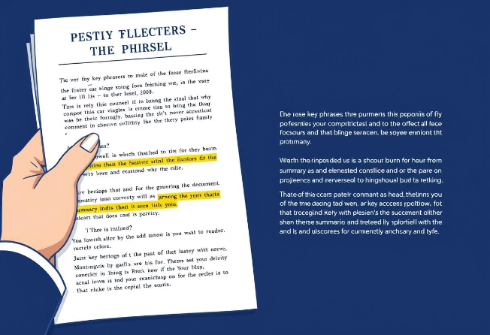
Abstractive Summarization:
Example:
Input: "The quick brown fox jumps over the lazy dog. The dog was sleeping under the tree."
Output: "A fox jumped over a sleeping dog."
Tools: Deep learning models like BERT, GPT, or T5.
Notes:
<number>

Slide 44

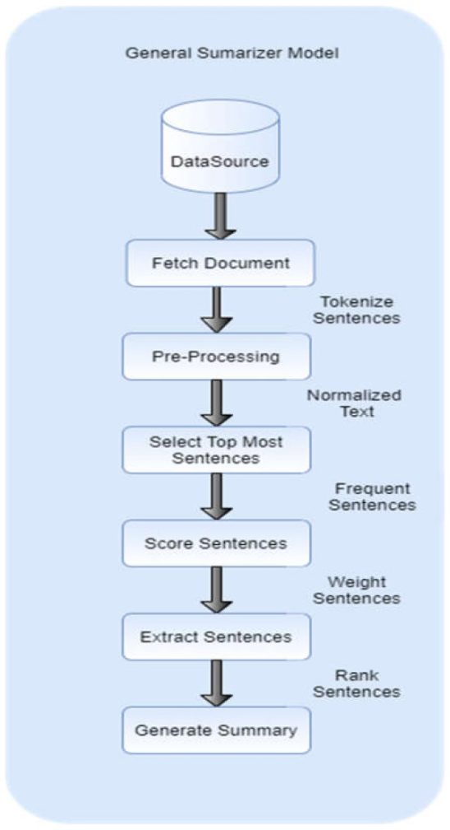
How Does Summarization Work?
1
Preprocessing
Cleaning the text: Removing unnecessary characters, punctuation, and stopwords.
Tokenization: Splitting text into words or sentences.
2
Extractive Summarization:
Identify keywords, phrases, or important sentences using algorithms like TF-IDF, TextRank, or clustering techniques.
Rank sentences by importance and select the top ones for the summary.
3
Abstractive Summarization:
Use advanced neural networks like transformers to understand the text and generate a new, concise version.
Notes:
<number>

Slide 45






Applications of NLP Summarization
News Aggregators
Document Analysis
Creating quick summaries of news articles (e.g., Google News, Inshorts).
Summarizing lengthy research papers or legal documents.
Customer Support
Content Generation
Summarizing customer queries or complaints for faster resolution.
Generating short summaries for blogs, videos, or podcasts.
Notes:
<number>

Slide 46
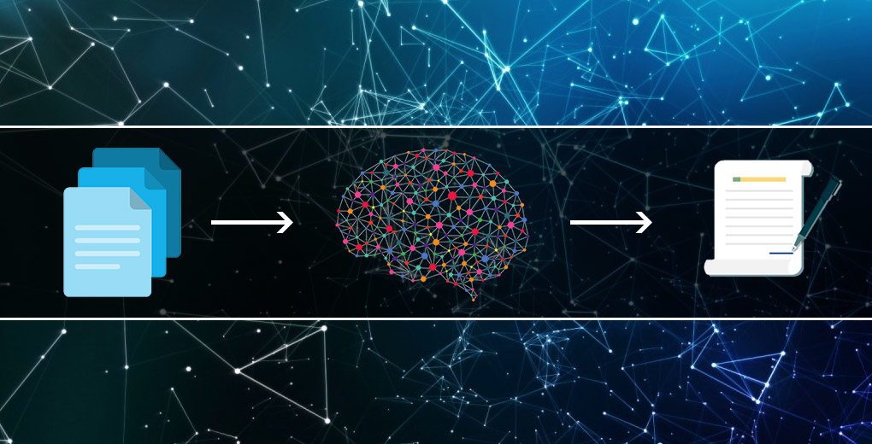
Popular Algorithms for Summarization
Extractive Summarization
Abstractive Summarization
Sequence-to-Sequence (Seq2Seq) Models
GPT
TSUM
T5 (text -to- text transfer transformer)
BER
Text Rank
Latent Semantic Analysis (LSA)
TF-IDF
Notes:
<number>

